Slide 1

Power of the crowds
Wisdom of the crowds
http://www.scaasymposium.org/portfolio/part-v-the-power-of-innovation-and-the-market/

Slide 2
Ensemble methods
A single decision tree does not perform well
But, it is super fast
What if we learn multiple trees?
We need to make sure they do not all just learn the same

Slide 3
Bagging
If we split the data in random different ways, decision trees give different results, high variance.
Bagging: Bootstrap aggregating is a method that result in low variance.
If we had multiple realizations of the data (or multiple samples) we could calculate the predictions multiple times and take the average of the fact that averaging multiple onerous estimations produce less uncertain results
Notes:
General purpose method, here only for decision trees

Slide 4
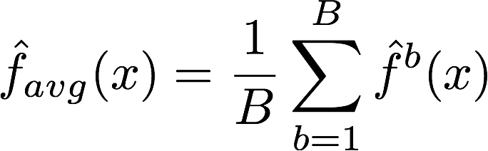
Bagging
Say for each sample b, we calculate f^{b}(x), then:
How?
Bootstrap
Construct B (hundreds) of trees (no pruning)
Learn a classifier for each bootstrap sample and average them
Very effective
Notes:
No pruning, high bias high variance

Slide 5
Bagging for classification: Majority vote
Test error
NO OVERFITTING

Slide 6
X₂
X₁

Slide 7
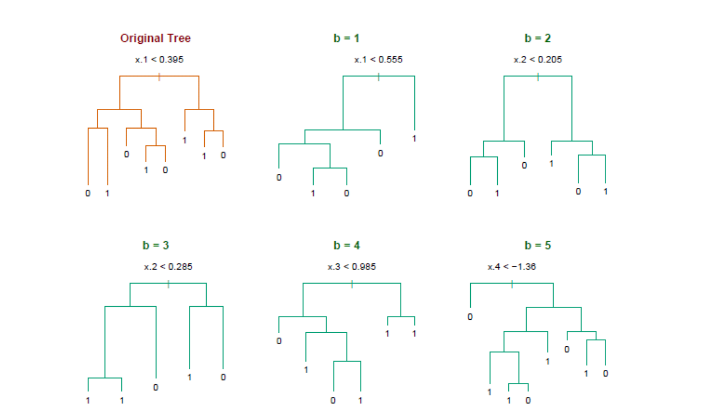
Bagging decision trees
Hastie et al.,”The Elements of Statistical Learning: Data Mining, Inference, and Prediction”, Springer (2009)

Slide 8
Out-of-Bag Error Estimation
No cross validation?
Remember, in bootstrapping we sample with replacement, and therefore not all observations are used for each bootstrap sample. On average 1/3 of them are not used!
We call them out-of-bag samples (OOB)
We can predict the response for the i-th observation using each of the trees in which that observation was OOB and do this for n observations
Calculate overall OOB MSE or classification error
Notes:
equivalent to leave-one-out cross-validation error
1/N to choose, 1-1/N not to choose, (1-1/N)N and (1-1/N) 1-(1-1/N)N 1-e^(-1)

Slide 9
Bagging
Reduces overfitting (variance)
Normally uses one type of classifier
Decision trees are popular
Easy to parallelize

Slide 10
Variable Importance Measures
Bagging results in improved accuracy over prediction using a single tree
Unfortunately, difficult to interpret the resulting model. Bagging improves prediction accuracy at the expense of interpretability.
Calculate the total amount that the RSS or Gini index is decreased due to splits over a given predictor, averaged over all B trees.

Slide 11
Using Gini index on heart data
Notes:
A variable importance plot for the Heart data. Variable importance is computed using the mean decrease in Gini index, and expressed relative to the maximum.

Slide 12
RF: Variable Importance Measures
Record the prediction accuracy on the oob samples for each tree
Randomly permute the data for column j in the oob samples the record the accuracy again.
The decrease in accuracy as a result of this permuting is averaged over all trees, and is used as a measure of the importance of variable j in the random forest.

Slide 13
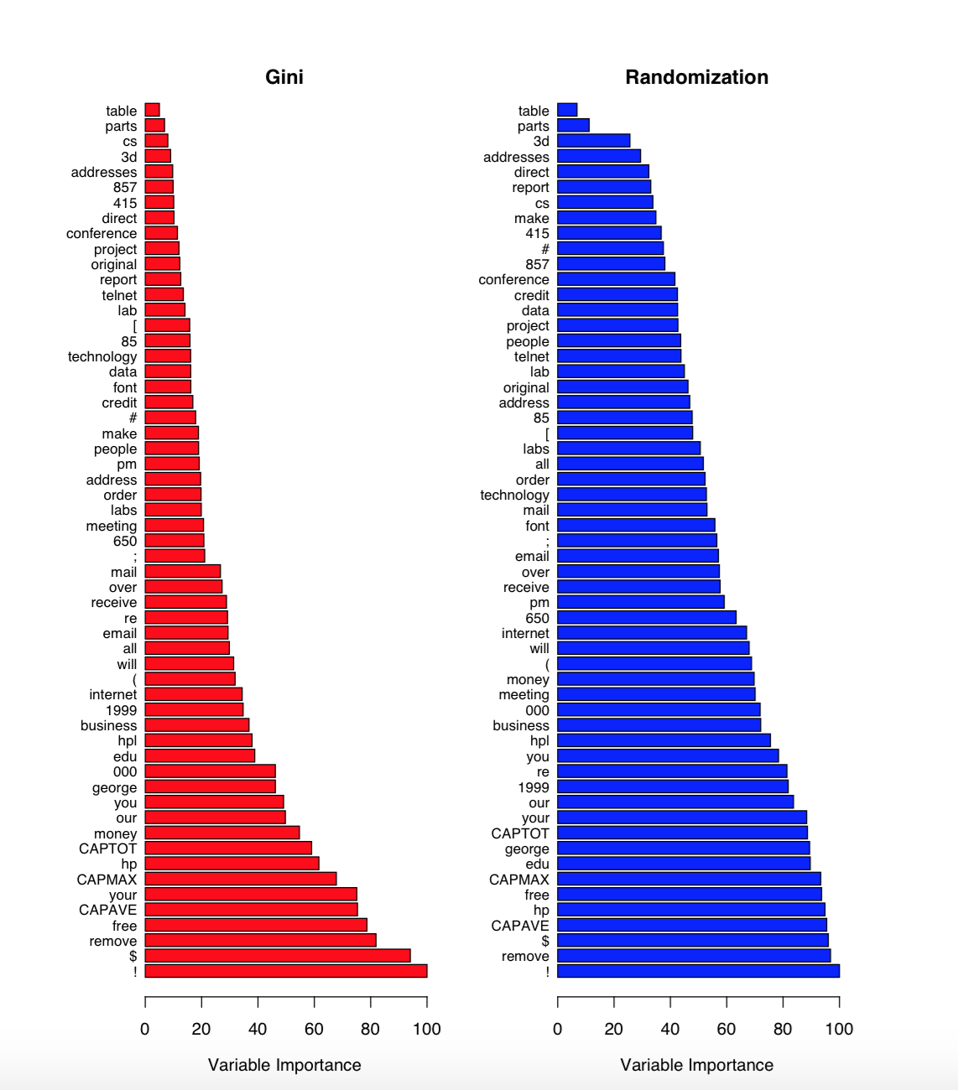

Slide 14
Bagging - issues
Each tree is identically distributed (i.d.)
➔ the expectation of the average of B such trees is the same as the expectation of any one of them
the bias of bagged trees is the same as that of the individual trees
i.d. and not i.i.d

Slide 15
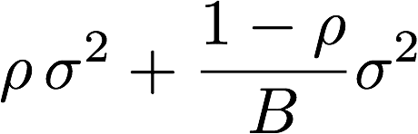
Bagging - issues
An average of B i.i.d. random variables, each with variance σ², has variance: σ²/B
If i.d. (identical but not independent) and pair correlation ρ is present, then the variance is:
As B increases the second term disappears but the first term remains
Why does bagging generate correlated trees?

Slide 16
Bagging - issues
Suppose that there is one very strong predictor in the data set, along with a number of other moderately strong predictors.
Then all bagged trees will select the strong predictor at the top of the tree and therefore all trees will look similar.
How do we avoid this?

Slide 17
Bagging - issues
We can penalize the splitting (like in pruning) with a penalty term that depends on the number of times a predictor is selected at a given length
We can restrict how many times a predictor can be used
We only allow a certain number of predictors
NO THE SAME BIAS
NO THE SAME BIAS
NO THE SAME BIAS

Slide 18
Bagging - issues
Remember we want i.i.d such as the bias to be the same and variance to be less?
Other ideas?
What if we consider only a subset of the predictors at each split?
We will still get correlated trees unless ….
we randomly select the subset !

Slide 19

Random Forests

Slide 20
Outline
Bagging
Random Forests
Boosting

Slide 21
Random Forests
As in bagging, we build a number of decision trees on bootstrapped training samples each time a split in a tree is considered, a random sample of m predictors is chosen as split candidates from the full set of p predictors.
Note that if m = p, then this is bagging.

Slide 22
Random Forests
Random forests are popular. Leo Breiman’s and Adele Cutler maintains a random forest website where the software is freely available, and of course it is included in every ML/STAT package
http://www.stat.berkeley.edu/~breiman/RandomForests/

Slide 23
Random Forests Algorithm
For b = 1 to B:
(a) Draw a bootstrap sample Z∗ of size N from the training data.
(b) Grow a random-forest tree to the bootstrapped data, by recursively repeating the following steps for each terminal node of the tree, until the minimum node size n_{min} is reached.
i. Select m variables at random from the p variables.
ii. Pick the best variable/split-point among the m.
iii. Split the node into two daughter nodes.
Output the ensemble of trees.
To make a prediction at a new point x we do:
For regression: average the results
For classification: majority vote

Slide 24
Random Forests Tuning
The inventors make the following recommendations:
For classification, the default value for m is √p and the minimum node size is one.
For regression, the default value for m is p/3 and the minimum node size is five.
In practice the best values for these parameters will depend on the problem, and they should be treated as tuning parameters.
Like with Bagging, we can use OOB and therefore RF can be fit in one sequence, with cross-validation being performed along the way. Once the OOB error stabilizes, the training can be terminated.

Slide 25
Example
4,718 genes measured on tissue samples from 349 patients.
Each gene has different expression
Each of the patient samples has a qualitative label with 15 different levels: either normal or 1 of 14 different types of cancer.
Use random forests to predict cancer type based on the 500 genes that have the largest variance in the training set.
Notes:
There are around 20,000 genes in humans , and individual genes
23 chromosomes (2 x )

Slide 26
Null choice (Normal)

Slide 27
Random Forests Issues
When the number of variables is large, but the fraction of relevant variables is small, random forests are likely to perform poorly when m is small
Why?
Because:
At each split the chance can be small that the relevant variables will be selected
For example, with 3 relevant and 100 not so relevant variables the probability of any of the relevant variables being selected at any split is ~0.25

Slide 28
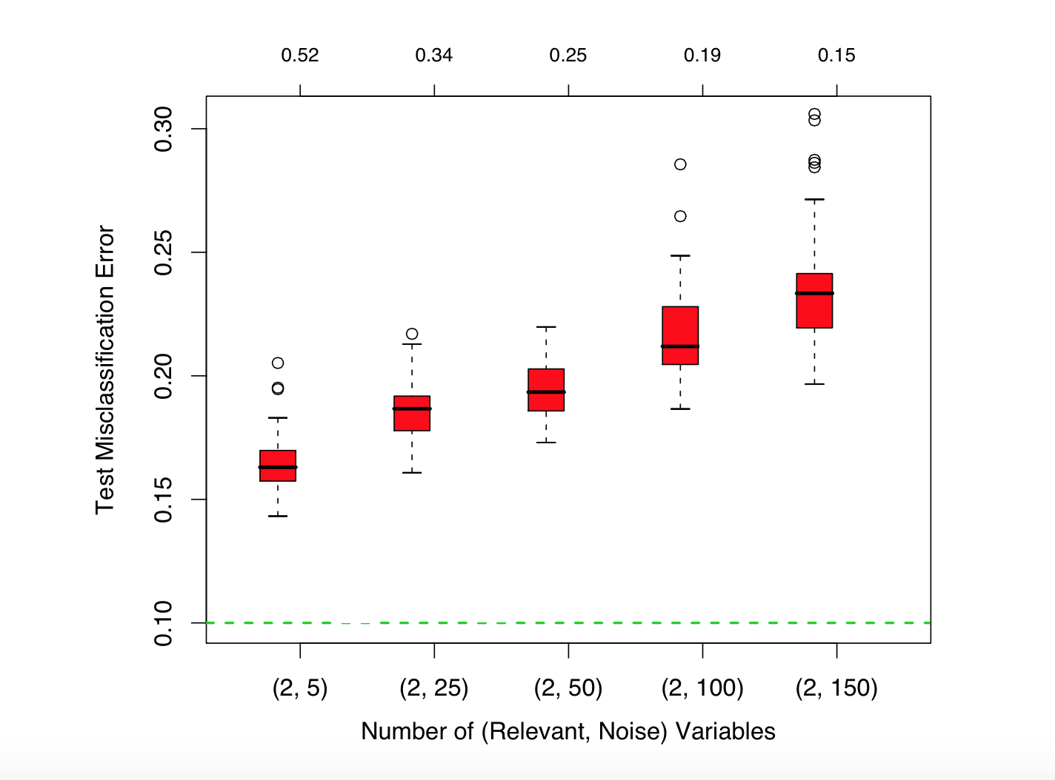
Probability of being selected

Slide 29
Can RF overfit?
Random forests “cannot overfit” the data wrt to number of trees.
Why?
The number of trees, B does not mean increase in the flexibility of the model

Slide 30
I have seen discussion about gains in performance by controlling the depths of the individual trees grown in random forests. I usually use full-grown trees and seldom it costs much (in the classification error) and results in one less tuning parameter.

Slide 31
Outline
Bagging
Random Forests
Boosting

Slide 32
Boosting
Boosting is a general approach that can be applied to many statistical learning methods for regression or classification.
Bagging: Generate multiple trees from bootstrapped data and average the trees.
Recall bagging results in i.d. trees and not i.i.d.
RF produces i.i.d (or more independent) trees by randomly selecting a subset of predictors at each step

Slide 33
Boosting
Boosting works very differently.
Boosting does not involve bootstrap sampling
Trees are grown sequentially: each tree is grown using information from previously grown trees
3. Like bagging, boosting involves combining a large number of decision trees, f¹, . . . , f^{B}

Slide 34
Sequential fitting
Given the current model,
we fit a decision tree to the residuals from the model. Response variable now is the residuals and not Y
We then add this new decision tree into the fitted function in order to update the residuals
The learning rate has to be controlled

Slide 35


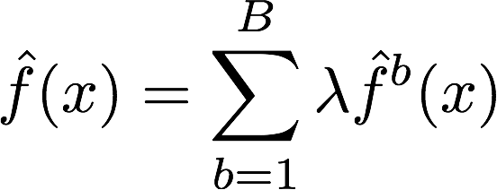
Boosting for regression
1. Set f(x)=0 and r_{i} =y_{i} for all i in the training set.
2. For b=1,2,...,B, repeat:
a. Fit a tree with d splits(+1 terminal nodes) to the training data (X, r).
b. Update the tree by adding in a shrunken version of the new tree:
c. Update the residuals,
3. Output the boosted model,

Slide 36
Boosting tuning parameters
The number of trees B. RF and Bagging do not overfit as B increases. Boosting can overfit! Cross Validation
The shrinkage parameter λ, a small positive number. Typical values are 0.01 or 0.001 but it depends on the problem. λ only controls the learning rate
The number d of splits in each tree, which controls the complexity of the boosted ensemble. Stumpy trees, d = 1 works well.

Slide 38
Boosting for classification
Challenge question for HW7

Slide 39
Different flavors
ID3, or alternative Dichotomizer, was the first of three Decision Tree implementations developed by Ross Quinlan (Quinlan, J. R. 1986. Induction of Decision Trees. Mach. Learn. 1, 1 (Mar. 1986), 81-106.) Only categorical predictors and no pruning.
C4.5, Quinlan's next iteration. The new features (versus ID3) are: (i) accepts both continuous and discrete features; (ii) handles incomplete data points; (iii) solves over-fitting problem by (very clever) bottom-up technique usually known as "pruning"; and (iv) different weights can be applied the features that comprise the training data.
Used in orange http://orange.biolab.si/

Slide 40
Different flavors
C5.0, The most significant feature unique to C5.0 is a scheme for deriving rule sets. After a tree is grown, the splitting rules that define the terminal nodes can sometimes be simplified: that is, one or more condition can be dropped without changing the subset of observations that fall in the node.
CART or Classification And Regression Trees is often used as a generic acronym for the term Decision Tree, though it apparently has a more specific meaning. In sum, the CART implementation is very similar to C4.5. Used in sklearn

Slide 41
Missing data
What if we miss predictor values?
Remove those examples => depletion of the training set
Impute the values either with mean, knn, from the marginal or joint distributions
Trees have a nicer way of doing this
Categorical

Slide 42
Further reading
Pattern Recognition and Machine Learning, Christopher M. Bishop
The Elements of Statistical Learning
Trevor Hastie, Robert Tibshirani, Jerome Friedman
http://statweb.stanford.edu/~tibs/ElemStatLearn/printings/ESLII_print10.pdf

